Slide 1
COMP 3008 – Assignment 4 Presentation
Danny Luu
Bora Sabuncu
Chris Cowan
Bjorn Vardal

Slide 2
Tablet Examination System
Goal
Provide an examination software geared to towards educational institutions
Students will us a tablet device iPad or Android, to write their exam
All exams will be done over a server where answers will be backed up and saved
The system will also support digital marking where it can be done online
Most importantly, prohibit the device from being used maliciously

Slide 3

Users
Professors
Teaching Assistants
Proctors
Students

Slide 4

Features
Login Screen
Professor, Proctor, Students and TA’s
Examination Screen – unique to each user
Proctor Screen – for aiding with the examination process
Professor Screen – for aiding students with questions and updating exam mistakes
TA Screen – has more functionality than Proctors

Slide 5
Exam Options
Multiple choice
Short/Long answers
Essay questions – Not unless a keyboard is provided

Slide 6

Tasks
Professor
Create Exams on the server i.e. using the backend of the system
Respond to students for assistance

Slide 7

Tasks
Proctors
Supervise the examination
Verifying the student ID’s
Locking all device in case of an emergency
i.e. Fire Alarm
Logging restroom usage

Slide 8

Tasks
Student
Logging into the system
Use the Tablet Examination System for their exam
Ask for assistance
i.e Professor for clarifying a question

Slide 9
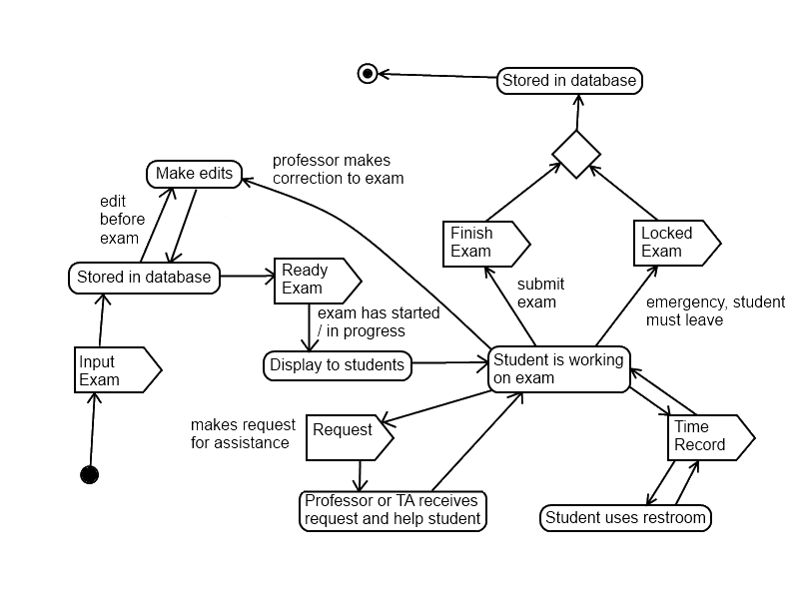
Artifact Analysis

